Slide 2
The Anatomy of Type
Type images can be taken for granted, but choosing from a list of fonts takes care & understanding.
If you think of letter forms as designs in their own right , you will be prepared to create interesting layouts with typography.
You may find some fonts become your favourites but be careful how you use them!
E.g. you might decide that Bauhaus is a favourite of yours, but whilst it might be an effective font to use for a heading or as part of a poster design, it should be avoided in formal letters, stories or magazine articles where the text content is more important than the design.
In this lesson you will learn how to make more practical choices rather than just using a typeface because you like the look of it.

Slide 3
Language of Letterforms
Crossbar
Stem
Terminal
Body size
Link
Cap-height
Counter
Ear
Ascender
Bowl
X-height
H f x g b
Descender
Impact of x-height
The x-height is the height of a lower case x and determines the visual size of type. The x-height varies from typeface to typeface; some like Bodoni have a small x-height, while Times New Roman has a large x-height. However each type has the same body size.
x x dp dp
Times New
Roman
Bodoni MT
Times New
Roman
Bodoni MT
Type with large x-heights tend to have small ascenders & descenders whereas type with small x-heights have large ones.

Slide 4
Sans Serif & Semi Serif letters Debate continues as to whether sans is harder to read as text copy than serif faces. Digital typographers have begun to negate such categories by introducing forms like semi serif and mix.
Bracketed Serif
Hairline Serif
Slab Serif
Sans Serif
Semi Serif
x x x x x
Times New Roman
Industrial 736 BT
BacktalkSerif BTN
Arial
Village Plain
Serif letters There are general groups of serifs: bracketed, hairline, slab or slab bracket.
o o o o o
Counters The counter is the space enclosed within a character. It will vary in size between typefaces.
Type with small counters tends to look darker on the page.

Slide 5
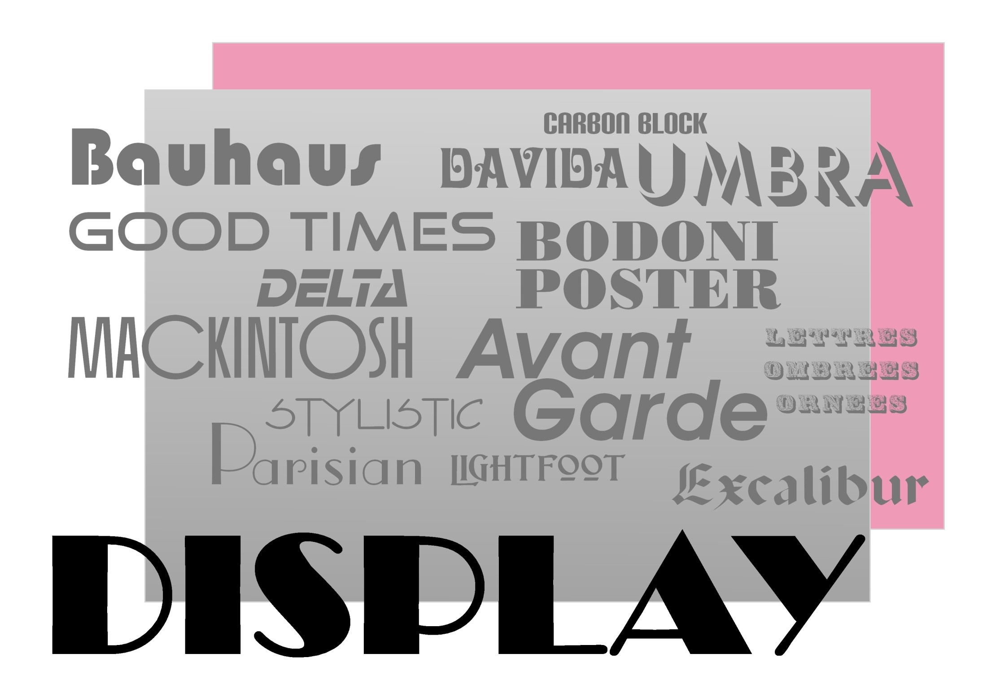

Slide 6
“Display fonts are the extroverts of the font world – so they should be treated with extra caution.” Mark Penfold
Display type is what you notice first on the printed page. It has character, it sets tone and it’s big – sometimes really big. So be careful how you use it.

Slide 7
Display
Clarity is vital
“How well does the typeface read at the intended size(s) and distance(s)? Ask someone else to look at it. Can they actually read it? Just because a typeface ‘looks’ cool doesn’t mean it will ‘read’ cool.” – Neil Summerour
Character-forming
“A good display font gives a more playful, daring, sexy and emotional feel to your design. If you are frightened by these words then don’t use one. Use a display font in the same way you would add spice to your food.” – Oded Ezer
Mixing it up
“Try selecting a font that is familiar to a specific use or type of design, and use it for something completely different. For instance, select a font that is more familiar in pub windows and try it for an exhibition.” – Jeff Knowles

Slide 8
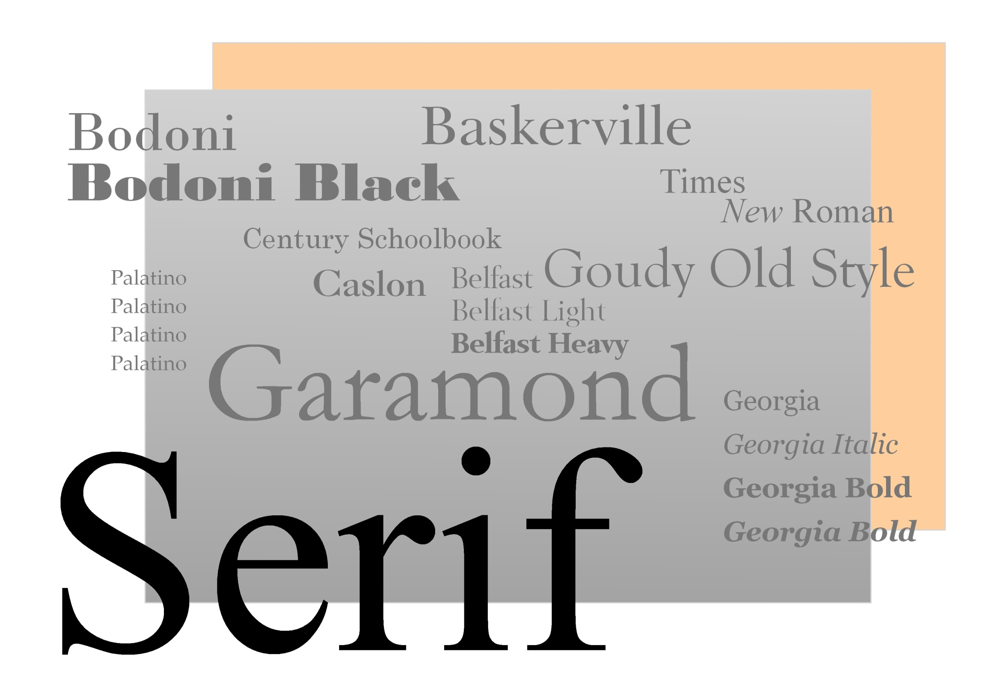

Slide 9
“Whether you want a modern feel or the weight of history, choosing the right serif font can work.” Garrick Webster
People always use the word ‘classic’ when it comes to serif type. Perhaps it’s to do with how closely the letterforms hark back to the calligraphic script used in the 16th century when printing presses spread across Europe. Designers generally start with a serif when they want to put a sense of age or authority into their project.

Slide 10
Serif
Point Size
Be wary when using typefaces with extended and narrow serifs like Didot. If used at a small point size the serifs can disappear into the paper.
How big?
Adobe Minion Pro comes with guidelines as to what size to use the typeface for different applications such as caption (6-8,4pt), regular (8.5-13pt), subhead (13.1-19.9pt) and display (over 20 pt).
Serifs on black
Selecting a font with robust serifs or going up in weights will avoid problems with loss of registration which can render the body text unreadable (serifs filling in).

Slide 12
“A classic sans-serif typeface should be hard-working and timeless. It should be hard to date, it could have been designed five years ago, but equally you wouldn’t be surprised if it was designed 105 years ago.”Jeff Knowles
These are the typefaces that, more than serifs, displays or slabs, deliver character. Sans-serifs are pliable, each has its own identity, but multiple weights and volumes offer subtle modifications.

Slide 13
Sans-serif
Kern letters
Headlines and bold display use of sans-serif typefaces always require careful kerning. With fonts in which small features can more easily be seen in a tight setting, tighter kerning can amplify the impact of the words. Shorter words tend to respond better to aggressive kerning.
Mix x-heights
If you are using several sans-serif types in a text-heavy project like a newspaper or magazine spread, think about x-heights. A high x-height in the body font makes it more legible, so pair it with a low x-height for the display or call-out font.
Break-out letters
Think carefully about any break-out faces such as drop caps and call-out fonts, especially if you’re mixing sans-serif faces or weights. Often a bold, black or even italic will give a crisper outline and shape for a first paragraph drop cap than the body weight.

Slide 14
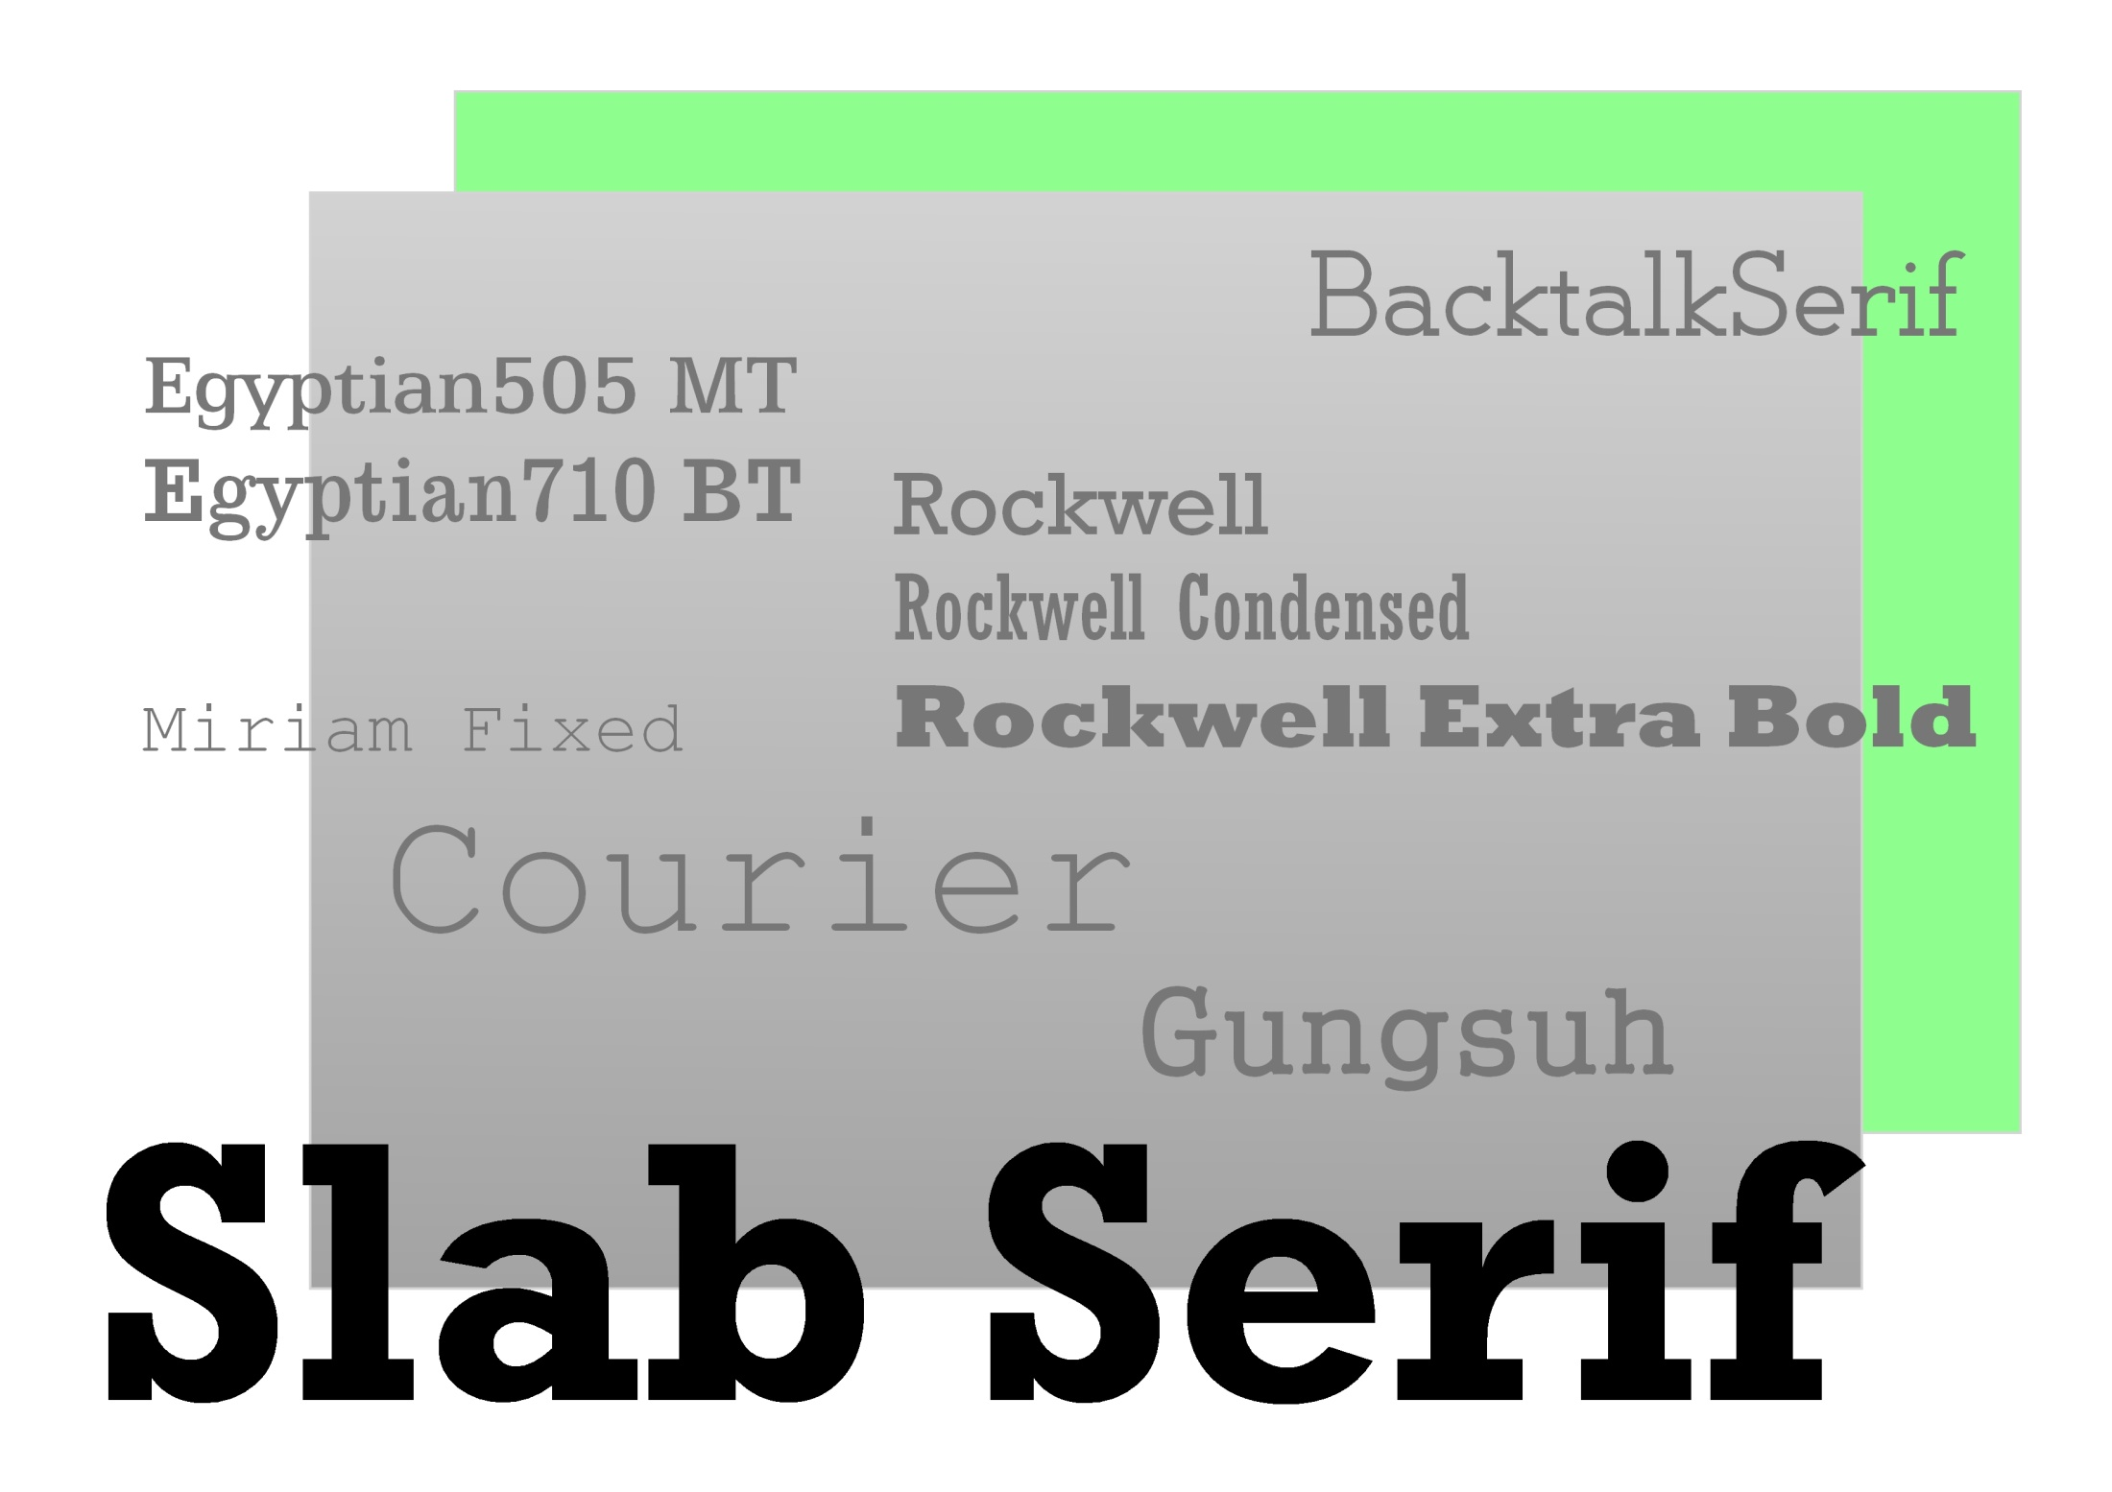

Slide 15
“Looking for a headline font – or an interesting body font? Slab serifs are the middle ground between display and serif.”Computer Arts Projects 2011
Regardless of historical reference – from Clarendon to Neo-grotesque – slab serifs are suitable for publication design and corporate identities, and work across print and digital with ease, providing the designer with a powerful and genuinely useful set of fonts that can come into play on any design project.

Slide 16
Slab Serif
A happy medium
The slab serifs are the right choice if you want to mix the classic touch of a serif with the freshness of sans-serif and it will help your design stand out from the crowd.
Leading lights
Slab serifs that include light weights can be used for body copy as an interesting alternative to serifs. The leading will need to be expanded to balance the extra detail at smaller point sizes.
Use your space wisely
Proper spacing and kerning are required. Slabs usually have pronounced serif structures that demand a certain level of attention due to the negative shapes they create. Being aware of the sort of slab being used in context will help you space it accordingly.

Slide 17
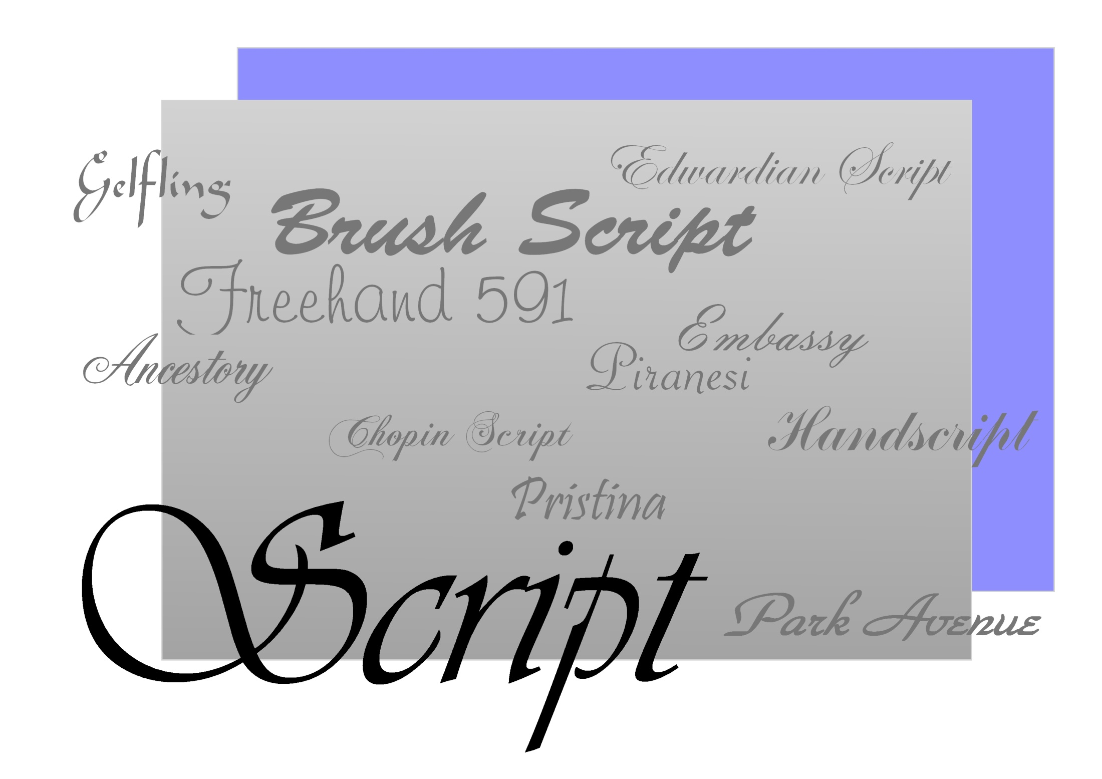

Slide 18
“Script fonts are generally created in a number of styles. There are the formal scripts, derived from 17th century formal writing styles; casual scripts – more modern fonts that commonly have variable width strokes, and are designed to look informal or handwritten – and calligraphic scripts which emulate calligraphy.” -Charlotte Rivers

Slide 19
Script
No body text
Never try to use a script for any running text, as readability will suffer. If you want a feel that emulates a script font for running text, a good quality italic font will always be a better option.
Don’t shout
Generally don’t set words entirely in capital letters when using a script. Most script fonts are meant to be used in either title/proper mode or in lower case only. All-caps script will really harm the readability.
Use sparingly
Only use scripts as headlines or as ‘accents’. The main exception to the rule might be where a script is intended to look like handwriting or invitations – but even then it should be used sparingly.

Slide 20
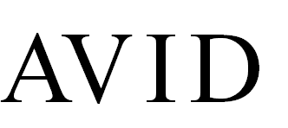
Spacing
It is unlikely that you will have to make adjustments to spacing in your main copy.
In many cases layouts will consist of pictures, captions and copy, either in the form of headings (display type) or main copy (text).
However the main object in text is to try & achieve a visual evenness through the characters. This consistency is important because when we read we interpret shapes of words rather than individual letters. In display copy, if there is unevenness in the letter spacing the eye can be distracted by the space rather than seeing the shapes. As the type size increases the unevenness can get worse, so adjustments are necessary. The problem is particularly bad when using upper case because of the way the letters fit together.
AVID
The unevenness of visual spacing means the spaces between V, I & D need to be made bigger.
You will need to decide about typefaces, sizes, measure (width of line) & spacing (letter, word & line) during the design process.
The result after applying ‘kerning in a DTP program.

Slide 21
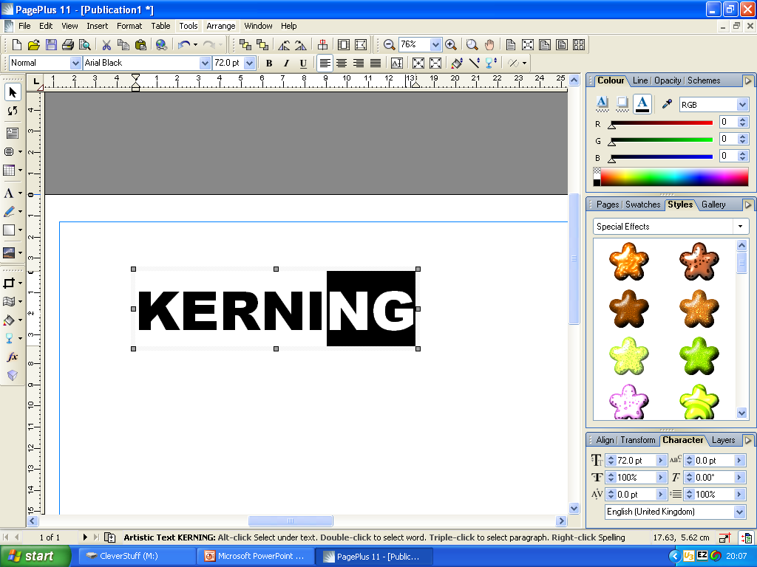
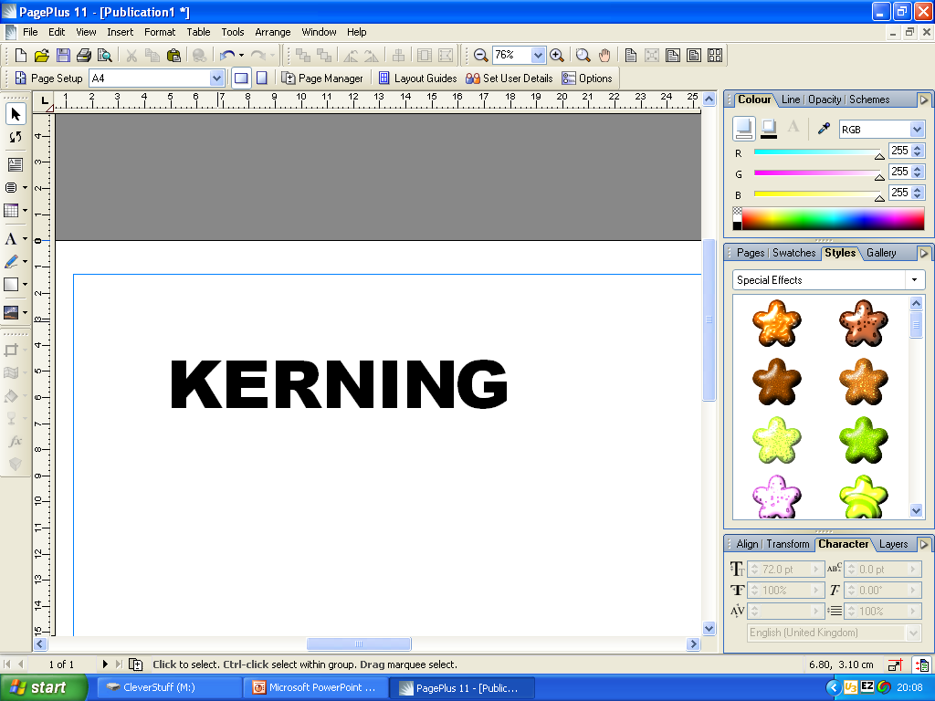
Kerning
Changing spaces between letters is very easy to do in Page Plus.
Highlight the two letters whose spacing you want to change.
To increase the space hold down ‘ctrl’, ‘alt’ and tap the ‘+’ key.
To decrease the space hold down ‘ctrl’, ‘alt’ and tap the ‘-’ key.

Slide 22
Word Spacing
In display text, a good guide for the amount of space between words is the width of a lower case ‘i’.
In main copy the style of typesetting plays an important part in the word spacing. There are two basic styles for setting type for continuous reading; fully justified & ranged left.
With justified setting, that is –alignment on both the right and left of the measure, the word spacing will vary because words are pushed out to fulfil the requirements of the measure. Herein lies the problem. The space can become excessive, particularly if the chosen measure is too small or the typeface too large. The result is often bad word spacing, which can cause ‘rivers’ of space to run down the page.
Hyphenation can be adjust-ed to even out the word spacing as far as possible, and avoid ugly spacing. Hyphenation specifications are sets of automatic hyphenation rules that you can create and apply to par-agraphs. You can specify the smallest number of char-acters that must precede an automatic hyphen (the de-fault is three), and the minimum number of char-acters that must follow an automatic hyphen (the de-fault is two).
With ranged-left setting you have the decided advantage of being able to space words consistently-the inherent difficulties of justified text can be avoided. For this reason, many designers prefer this style, though problems of legibility can still arise. As mentioned earlier, style of type also plays an important part in the amount of word spacing to have. Percentage adjustments can be made within the hyphenation-and-justification.
Justified setting with no word breaks
Hyphenation can reduce the problem of excessive word spacing.
Ranged-left style of setting

Slide 23
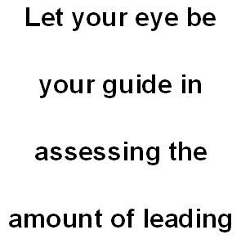
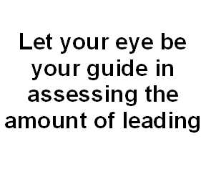
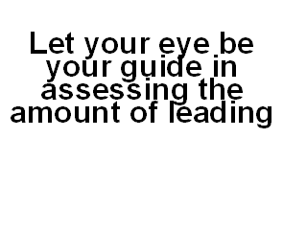
Leading
This term derives from ’hot metal’ typesetting, when strips of lead were placed between lines of type & refers to the amount of spacing between lines of type’
In display type you will invariably have to adjust individual lines and not just rely on a constant setting for the line space. This is very important when you use lower-case letters that contain variable amounts of ascenders and descenders. Ascenders and descenders used together in display text can sometimes clash visually. There are no clear rules regarding adjustments of liine spacing; it is a matter of skill and practice.
Too much leading can hamper readability as much as too little leading

Slide 24
Adjusting Leading in Page Plus
To alter leading in Page Plus, simply highlight the lines whose leading you wish to alter and either increase the percentage (increasing the spacing) or decrease the percentage (bringing the lines closer together) here.

Slide 25
Headings & dropped capitals
If headings are of varying levels of importance, try to make sure they are visually segregated.
For example the top level heading might be in 48pt, with the next one down being 24pt. Any closer in size and readers might have trouble separating one from another.
There are numerous ways in which you can play with headings to improve the visual feel of a design.. Breaking a line or word into different parts, or using alternating sizes with a heading, can look dynamic. For example, articles and conjunctions (‘the’, ‘a’, ‘and’, ‘or’, etc.) could be smaller to give the important words more stress.
Type performing certain functions has to be big (e.g. mastheads, billboards, newspaper headlines) in order to catch people’s eye.
Another way that size is used as a display element is in the use of dropped initial letters.

Slide 26
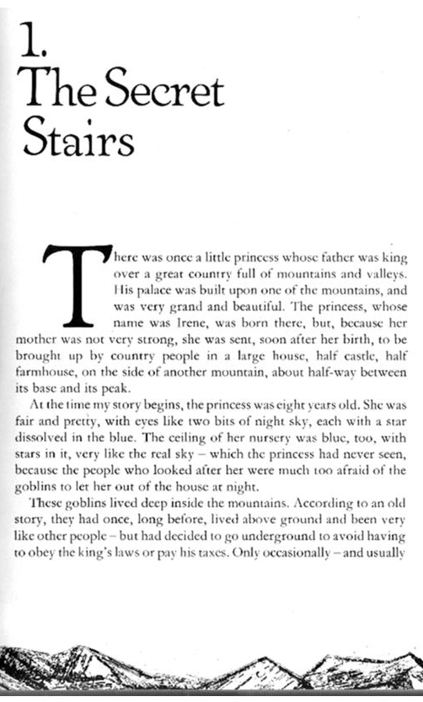
D
rop caps Using an initial drop cap is a way
of drawing the reader’s eye to the starting
point of the text. You can specify the number
of letters to be larger and how many drop lines you
want.
Examples of the use of drop caps from:
a newspaper, a reference book & a children’s story book.

Slide 27
Drop Caps in PagePlus
Highlight the letter you want to change into a Drop Cap.
Click on ‘Format’ & scroll down to ‘Drop Cap’ & click.

Slide 28
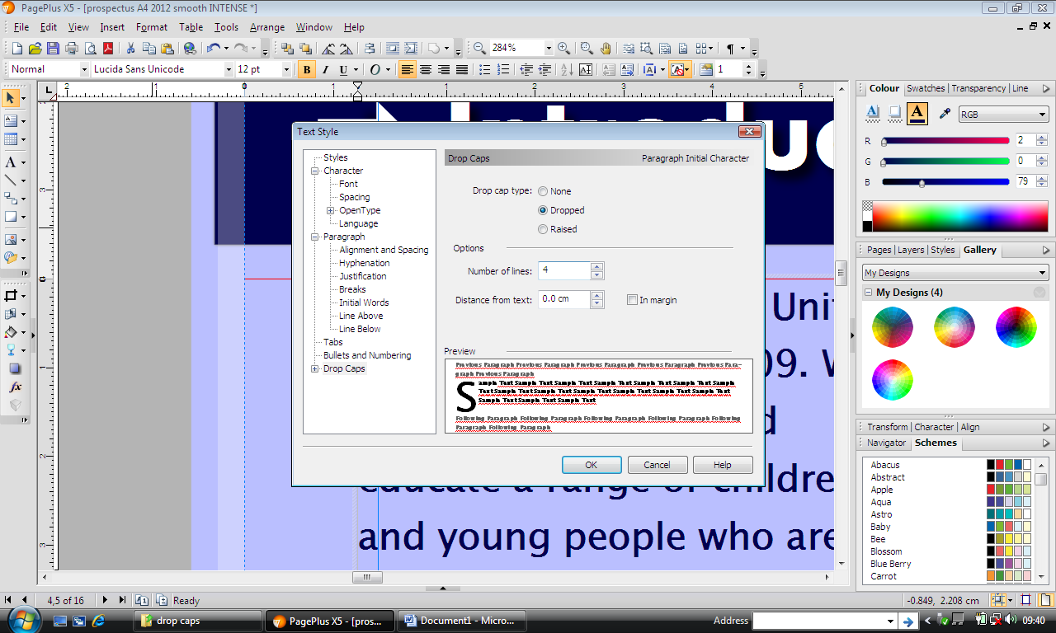
Drop Caps in PagePlus
Choose whether you want the letter to be dropped or in the margin & click on your choice
Choose how many lines you want to drop the capital here.

Slide 29
Drop Caps in PagePlus
You don’t have to keep the same font.
You can change the font here.
When you are happy with your choices click on ‘OK’.

Slide 30
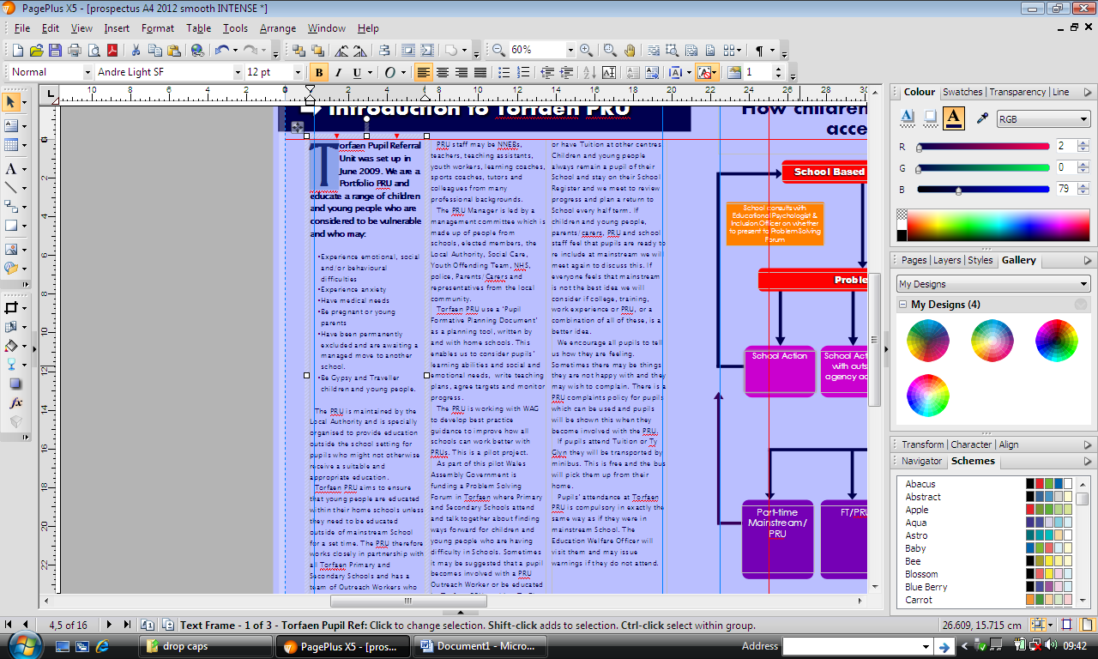
Drop Caps in PagePlus
This is how your Drop Cap will look.

Slide 31
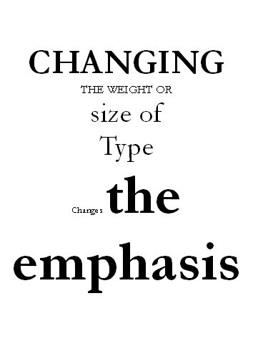
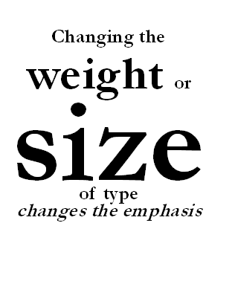
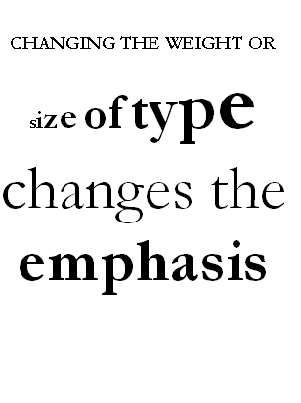

Slide 32
Readability and Legibility
Long passages composed entirely of capital letters are difficult to read because the words have similar rectangular outlines and lack ascenders and descenders.
The optimum number of characters to a line is between 60 and 72. Anymore than this and the eye has problems picking up the next line. Fewer characters can interrupt the flow of reading because your head has to constantly move back and forth from one line to the next.
Different types of jobs will influence these decisions e.g. magazines have shorter measures because readers dip into articles; novels which need to cater for continuous reading will be different from adverts where impact is most important.
Type size and measure also depends on how much copy there is to read. Readers can cope with small amounts of copy if the setting is smaller or on a narrower measure than the optimum.

Slide 33
Typefaces or Fonts Recap
Sans serif fonts with their simple structure are used for road signage. Sans serif is also ideal when type has to be small, as in some diagrams and maps.
Subject matter can influence your choice: Caslon and Baskerville are classical English, Garamond is French, Goudy is American, Bodoni is Italian.
Sans serif and slab serif faces are more authoritative. These are also good fonts to use if you are reversing out type or printing on to tints in small sizes.
Serif fonts have elegance and a more subtle approach.
Do not use too many different fonts in your main copy (no more than three) and try to use fonts that complement one another and are from the same family. Main copy containing a hairline serif, a slab serif and a sans serif is likely to look ugly and cluttered, especially if there are large differences in x-height..

