Slide 1
TYPOGRAPHY
The art of letters

Slide 5
m

Slide 6
m

Slide 7
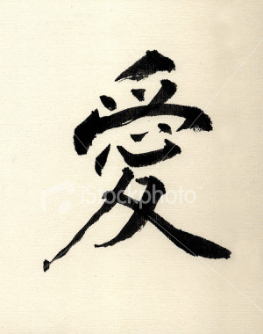

Slide 8
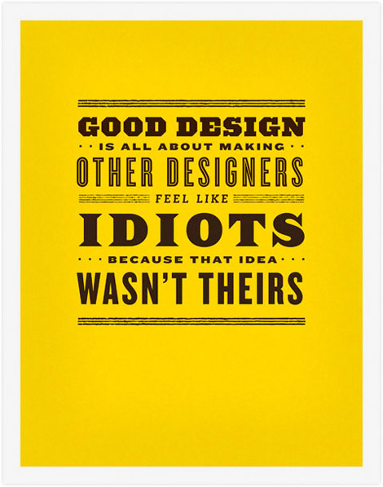

Slide 9
Graphic design is made up of 2 main components
Typography
Image

Slide 10
Typography
Is the art of designing and using letter forms
The term encompasses the Type face (font) layout and size.
Sometimes typography is all you need to communicate your ideas effectively.
Here are some examples....

Slide 12
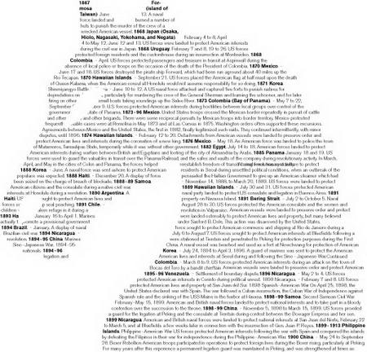

Slide 13
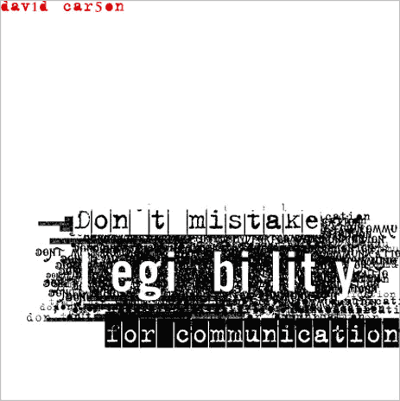

Slide 14
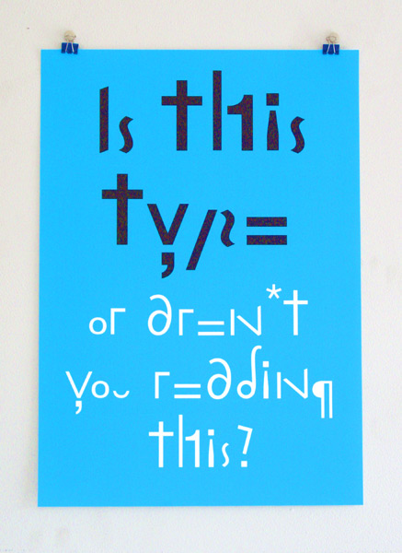

Slide 15
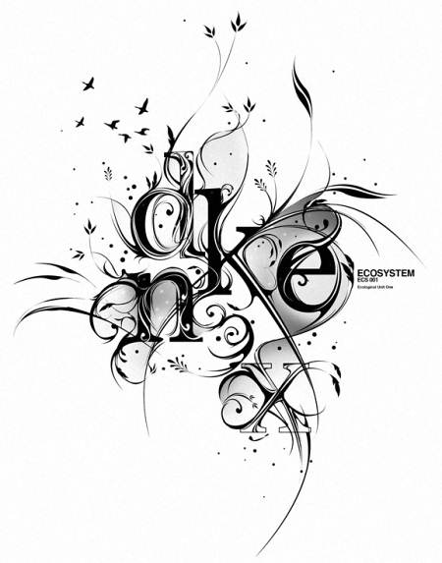

Slide 16
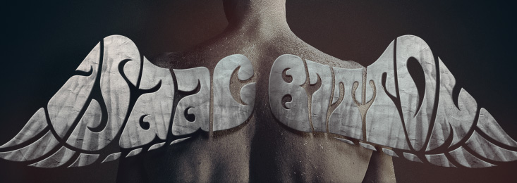

Slide 17
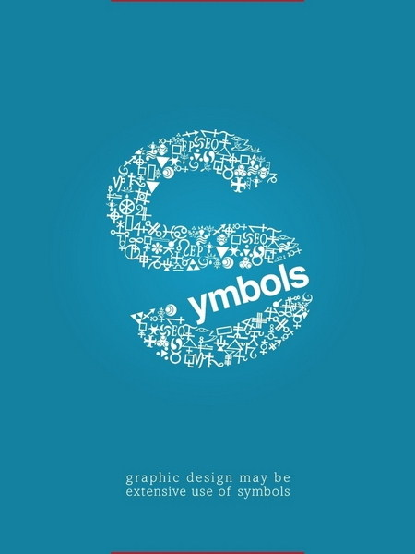

Slide 18
Neville Brody
Neville Brody is a well know graphic designer who has created many of his own type faces within his work.
He also is widely know for designing ‘The Face’ magazine and fetish record label.
His work inspired a whole generation of graphic designers.

Slide 19
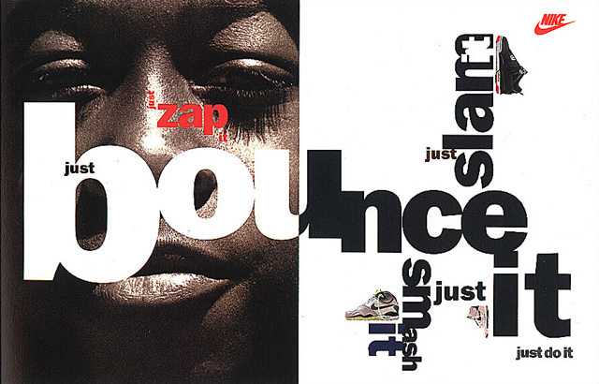

Slide 20
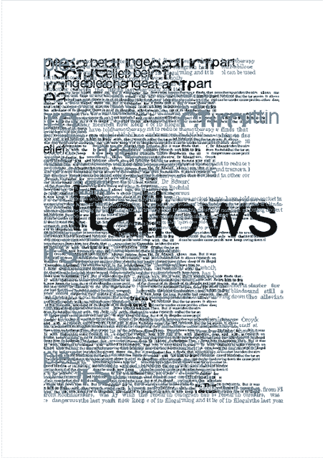

Slide 21
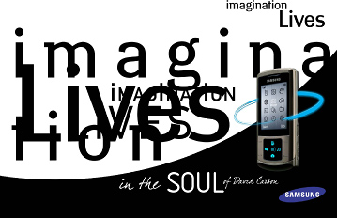

Slide 22
Image.
Image in design is also important.
Image is there to back up the text and add dimension to the work.
Images can be literal or slightly subversive.

Slide 26
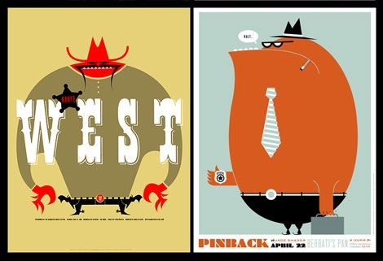

Slide 27
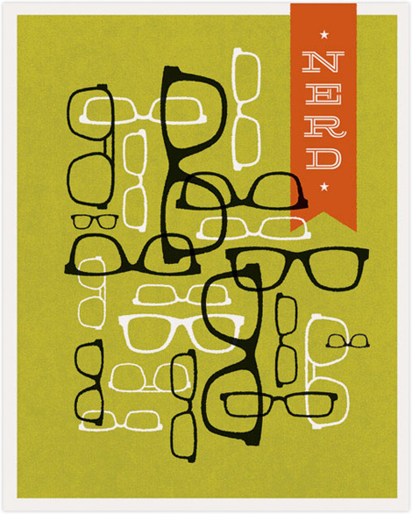
Frank Chimero

Slide 28
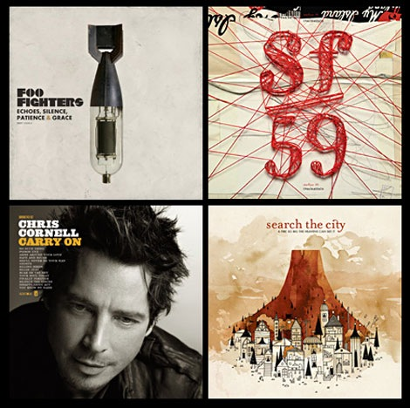

Slide 29
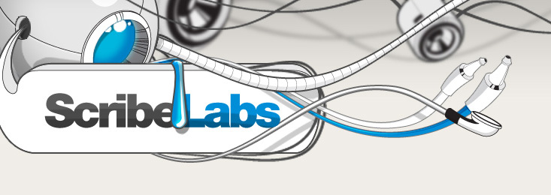
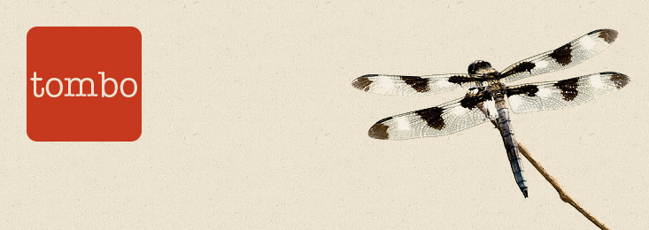

Slide 30
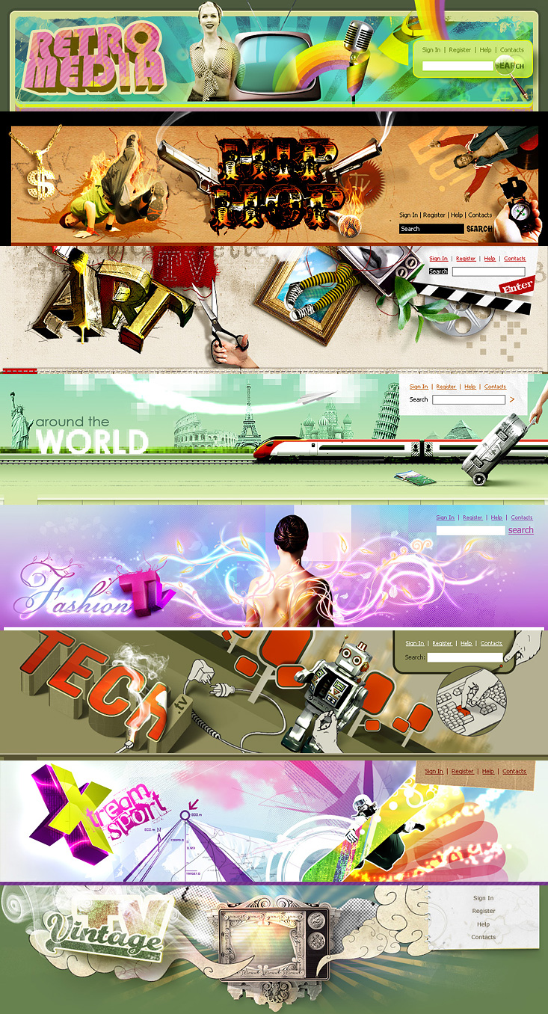

Slide 31
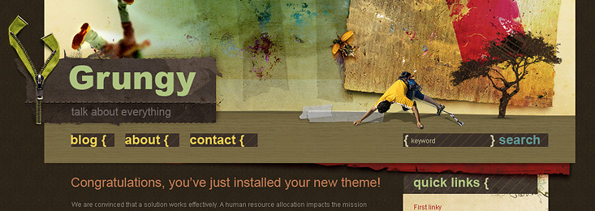
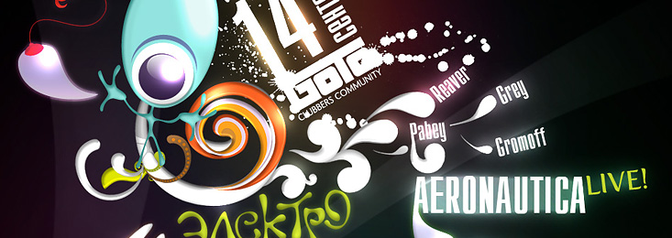

Slide 32
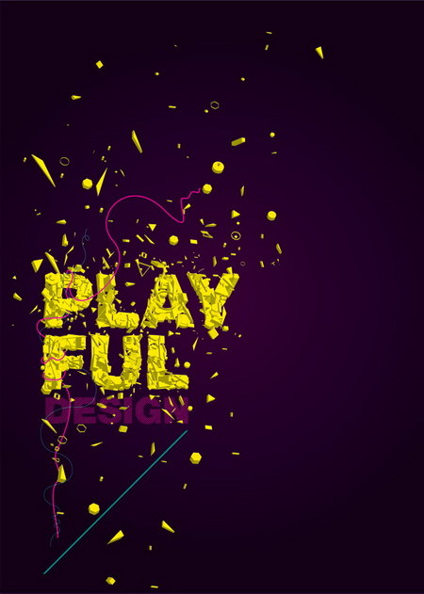

Slide 33
